Slide 1
A101 Science
Problem 06: More means higher
6th Presentation
Copyright © 2010

Slide 2
Determining boiling points
When substances boil, it turns from a liquid to a gas.
During boiling, the molecules of the substance move faster and further apart. This means that inter-molecular interactions are being broken.
Since inter-molecular interactions are broken during boiling, boiling points should increase with the strength of inter-molecular interactions.

Slide 3
Determining strength of interactions
In P05 Marvelous Molecule we learnt that inter-molecular interactions arise from the partial charges due to an uneven distribution of a molecule’s electron cloud. The strength of these interactions depend on:
  The magnitude of the partial charges
  The permanence of the partial charges
Polar molecules have stronger interactions (thus higher boiling points) than non-polar molecules because their partial charges are permanent and also generally greater in magnitude.

Slide 4
Determining the presence of polar bonds
To compare the boiling points of CH₃F, CH₂F₂ and CF₄, their type of inter-molecular interactions need to be compared.
All three molecules contain either C-H or C-F bonds.
The difference in electronegativity between C and H is 0.35 (= 2.55 – 2.2). C-H bonds are non-polar.
However, the difference in electronegativity between C and F is 1.43 (= 3.98 – 2.55). Thus, C-F bonds are polar and the electron cloud around the molecule is pulled towards F.

Slide 5

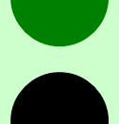
Examining CH₃F
Dipole Moment
Dipole Moment
Note how the presence of the F atom causes both the bonding electrons and the molecule’s electron cloud to shift.

Slide 6
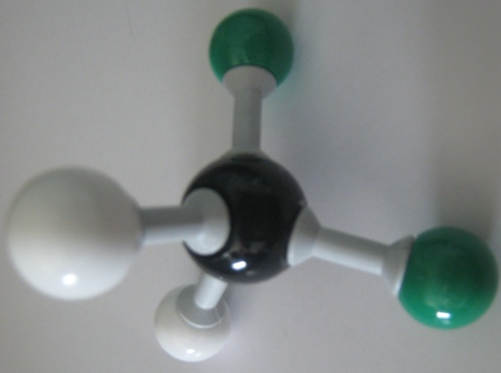
Examining CH₂F₂ – Net dipole moment
Class activity using the movement of the model as an analogy to demonstrate net dipole moment.
CH₂F₂ has two F atoms.
Their respective dipole moments are shown in orange.
The net dipole moment, (overall effect of all dipole moments)
is shown in red can be visualised by imagining a pull
on the electron cloud in those directions.
Notes:
Note:
The net dipole moment can also be determined using the activity in the worksheet.
Using the activity, we will pull the molecular model of CH₂F₂ in the directions of the dipole moments (as shown by the orange arrows) and the model will move in a resultant direction (as shown by the red arrow).

Slide 7
Comparison between CH₃F and CH₂F₂
Since CH₂F₂ has two dipole moments that work together,
it has a stronger net dipole and thus stronger partial charges
(represented here as darker colours) than CH₃F.
CH₂F₂ thus has stronger inter-molecular interactions and
a higher boiling point than CH₃F.

Slide 8
Examining CF₄ – non-polar molecule with polar bonds
CF₄ has the most polar bonds,
and thus the most dipole moments.
However, based on the activity, it can
be seen that the dipole moments act
against each other and cancel out.
Thus, CF₄ has the most polar bonds among the three molecules, but has zero net dipole moment and is non-polar.
Non-polar molecules have only temporary charges and can only form weak interactions. As a result, CF₄ has a lower boiling point than both CH₃F and CH₂F₂.
Notes:
Although CF₄ has a lower boiling point than both CH₃F and CH₂F₂, it still has a higher boiling point than CH₄.
Since F is larger than H, CF₄ has a larger electron cloud than CH₄.
The random movement of electrons in CF₄ would be able to produce larger partial charges than in CH₄. Hence, CF₄ has stronger intermolecular interactions and a higher boiling point than CH₄.
This concept is further elaborated in the post reading material at the end of the 6P.

Slide 9
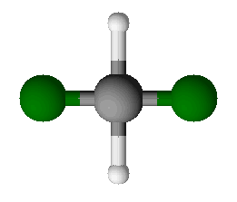
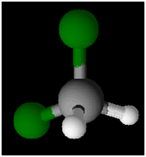
Going further
Non-Polar
Polar
Shape is a very important consideration in determining whether a molecule is polar or not.
The shape of a molecule is determined by the repulsion between electron pairs.
All the electron pairs are arranged such that there is minimum repulsion between them.
Minimal repulsion is usually achieved through approximately equal repulsion among all the bonds.

Slide 10

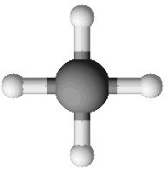
Determining shape through repulsion
Top View Used:
Less stable
More stable
Larger angle
Less repulsion
Smaller angle
Greater repulsion
Equal angle
Equal Repulsion

Slide 11

Determining shape through repulsion
Isometric View Used:
Top View Used:
Less stable
More stable
Larger angle
Less repulsion
Equal angle
Equal Repulsion
Smaller angle
Greater repulsion

Slide 12

Shape of CO₂ molecules
Equal angle
Equal Repulsion
Although double bonds contain two pairs of electrons, they are still shared between the same two atoms.
When determining the shape of a molecule, a double bond can be treated as a single bond.
The same applies for triple bonds.

Slide 13
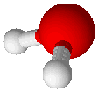
Shape of H₂O molecules
Equal Repulsion
When describing the shape of molecules, only the position of the atoms are considered.
However, lone pairs (pairs of non-bonding electrons) still repel other electrons and will influence the shape of molecules.
Note: Non-bonding electrons repel other electrons more strongly. Hence, the angle between them is greater than that between other electrons.

Slide 14
Learning points
Boiling involves breaking intermolecular interactions. Hence, boiling points are dependent on the strength of intermolecular interactions.
Greater polarity tends to increase the boiling point by increasing the magnitude of partial charges.
Each polar bond in a molecule exerts a dipole moment on the molecule’s electron cloud.
Depending on the shape of the molecule and the direction of the dipole moments, dipole moments can work together or cancel out. Hence, the polarity of a molecule can only be determined by finding the net dipole moment.

Slide 15
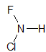
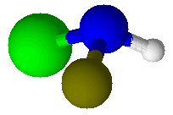
Discussion
The following information is about an unknown molecule.
The molecule consists of one nitrogen atom, one hydrogen atom, one chlorine atom and one fluorine atom.
There are two dipole moments in this molecule.
Sketch the structure of the molecule
Locate the two dipole moments in the molecule
Determine if there is a net dipole moment.
Position of lone pair of electrons
Element | Electronegativity Value
Nitrogen | 3.04
Hydrogen | 2.2
Chlorine | 3.16
Fluorine | 3.98
..
N
H
Cl
F

Slide 16
Post-problem reading material

